Slide 1
BUSINESS ETHICS
M. JASMINE FAIROSE MBA., M.PHIL.,
PG &RESEARCH DEPARTMENT OF COMMERCE,
JAMAL MOHAMED COLLEGE, TRICHY

Slide 2
MEANING OF BUSINESS
The term business refers to an organization or enterprising entity engaged in commercial, industrial, or professional activities. The purpose of a business is to organize some sort of economic production (of goods or services).

Slide 3
Definition of T.M. Garrett:
Business ethics is a study of the moral rightness or wrongness of the acts involved in the production, distribution and exchange of economic goods and services.

Slide 4
MEANING OF BUSINESS ETHICS
Business ethics refers to implementing appropriate business policies and practices with regard to arguably controversial subjects. Some issues that come up in a discussion of ethics include corporate governance, insider trading, bribery, discrimination, social responsibility, and fiduciary responsibilities.

Slide 5
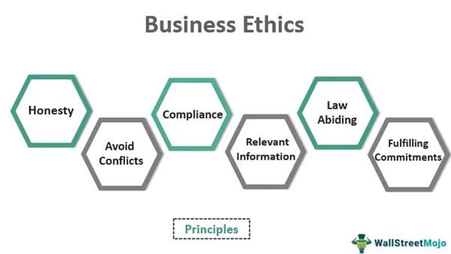
Principles of Business Ethics

Slide 6
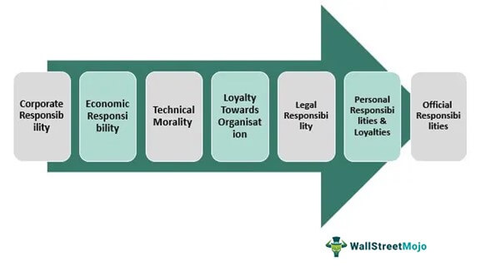
Types of Business Ethics

Slide 7
Why is business ethics important?
Business ethics ensure that companies operate according to all applicable laws. This maintains the company's respect among its peers and customers and protects it from legal liability. A company's ethics also help it attract quality team members. Businesses that care for their teams according to the highest ethical standards are often attractive to job seekers. Ethical treatment can also increase employee retention and reduce hiring and training costs.
A business that treats its customers or clients ethically can build trust and create longstanding relationships. These customers are likely to return and may recommend the business to people within their sphere of influence. Also, a business known for its effective ethical principles can gain respect and elevate the quality of its brand.

Slide 8
Need for Business ethics
Survival of the Business Unit
Growth of Business Unit
Earning Goodwill
Improving the Confidence
Maintaining Inter-relationship
Solving Social Problems

Slide 9
Factors which necessitate ethical behavior in business
Ours is an industrial society and its values tend to become those of the entire culture.
There is a growing awareness among the public. The society insists the business leaders to shoulder the responsibility for maintaining their welfare.
If an organization fails to live upon the expectations of the society, it will lose its market share, its prestige and reputation.
Unethical practices shall lead to Government control ultimately through legislation. Hence, prevention is better than cure.

Slide 10
THANK YOU

